Slide 1
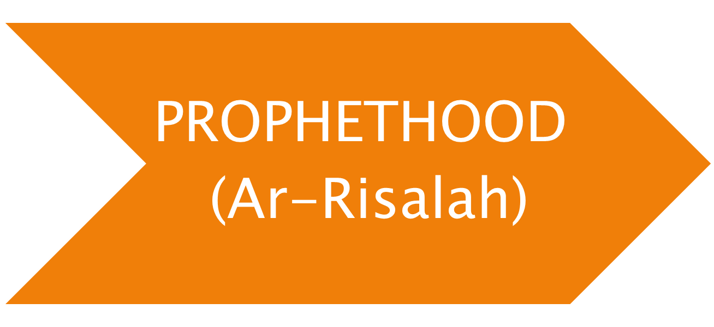
Islamic & Religious Studies Instructor: Prof. Abid Naeem

Slide 2

Second fundamental Islamic Aqeeda
A Unique Islamic Aqeeda
Prophet hood means the office of a Prophet deputed by Allah to mankind for conveying His commands and for becoming a role model for humans
Islamic & Religious Studies Instructor: Prof. Abid Naeem

Slide 3

Muslims have implicit faith in the prophet hood of all Prophets and Messengers from Adam to Muhammad
Belying anyone of them is, in fact, belying all and faith in anyone of them is incomplete without having faith in all
Muslims have staunch faith that all Prophets and Messengers were selected humans and were true, pious, worthy of our respect and they performed their duties according to directives of Allah and were successful in their missions
Islamic & Religious Studies Instructor: Prof. Abid Naeem

Slide 4

However, being the Last Prophet of Allah, Muslims follow the teachings revealed to Hazrat Muhammad (S.A.W.) ONLY.
And being the Last version of ISLAM, Muslims follow the teachings of ISLAM revealed to Hazrat Muhammad (S.A.W) only.
Islamic & Religious Studies Instructor: Prof. Abid Naeem

Slide 5

The prophets mentioned in the Holy Quran by their NAMES are only 25. According to chronological order, their names are as under:
QURANIC & ARABIC NAME BIBLICAL & ENGLISH NAME
(1) آدم Adam
(2) إدريس Enoch
(3) نوح Noah
(4) هود Eber
(5) صالح Saleh
(6) إبراهيم Abraham
(7) لوط Lot
(8) إسماعيل Ishmael
(9) إسحاق Isaac
(10) يعقوب Jacob
(11) يوسف Joseph
(12) أيوب Job
Islamic & Religious Studies Instructor: Prof. Abid Naeem

Slide 6

QURANIC & ARABIC NAME BIBLICAL & ENGLISH NAME
(13) شعيب Shoaib
(14) موسى Moses
(15) هارون Aaron
(16) داود David
(17) سليمان Solomon
(18) إلياس Elijah
(19) اليسع Elisha
(20) يونس Jonah
(21) ذو الكفل Ezekiel
(22) زكريا Zechariah
(23) يحيى John the Baptist
(24) عيسى Jesus Christ
(25) محمد Paracletos
Islamic & Religious Studies Instructor: Prof. Abid Naeem

Slide 7

Prophets sent to mankind were approximately ONE LAC, TWENTY FOUR THOUSAND (124,000)
(Mishkat-ul-Masabih, Hadith No: 5737)
Islamic & Religious Studies Instructor: Prof. Abid Naeem

Slide 8

NABI (PROPHET)
Derived from an Arabic word “نبوة”
LITERAL MEANING:
News Giving
So Nabi is a news giver
Islamic & Religious Studies Instructor: Prof. Abid Naeem

Slide 9

RASOOL (MESSENGER)
Derived from an Arabic root “رس ل”
LITERAL MEANING:
To Communicate message
So Rasool is a Communicator
Islamic & Religious Studies Instructor: Prof. Abid Naeem

Slide 10

Every Messenger/ Prophet receives Revelation [Wahi] by Allah
YET
A common man does not
Islamic & Religious Studies Instructor: Prof. Abid Naeem

Slide 11
WHAT IS THE DIFFERENCE BETWEEN NABI & RASOOL?
Islamic & Religious Studies Instructor: Prof. Abid Naeem

Slide 12

Every رسول (Messenger) is a نبی (Prophet) but not every Nabi is a Rasool
Messenger was recipient of a book OR
a scripture while Prophet simply taught
teachings already established through a book
OR a scripture by a former Messenger
For example, Hazrat Dawood was a Messenger and a Prophet as he received the book of Psalms; while his son, Hazrat Salman, however, was a Prophet but not a Messenger as he did not receive any named scripture.
Islamic & Religious Studies Instructor: Prof. Abid Naeem

Slide 13

This view, therefore, states that the following Prophets were Messengers too:
Ibrahim, as he received the Scrolls of Abraham
Mosa, as he received the Torah and the Scrolls
Dawood, as he received the Zabor
Isa, as he received The Injil
Muhammad, as he received the Holy Qur'an
Islamic & Religious Studies Instructor: Prof. Abid Naeem

Slide 14

The most common conclusion that scholars came to, is that ‘Messenger' and ‘Prophet' are indeed interchangeable words for each other
The only major difference is that the term ‘Messenger' is also used for angels, while ‘Prophet' is used specifically for humans
Therefore, some translators use the alternative phrase, ‘Apostle', when translating the word 'Rasul' in context of a human
Islamic & Religious Studies Instructor: Prof. Abid Naeem

Slide 15

To convey the message of Allah to humans & jinns
To be Role models
Islamic & Religious Studies Instructor: Prof. Abid Naeem

Slide 16

To teach the commands of Allah to mankind
To explain the commands of Allah and wisdom behind these commands
Mentors
Purifiers
Islamic & Religious Studies Instructor: Prof. Abid Naeem

Slide 17

Human beings
Pious creatures of Allah
Innocent (Free from sins)
Worthy of obedience
Islamic & Religious Studies Instructor: Prof. Abid Naeem

Slide 18

The religion of Islam revealed to Hazrat Muhammad (S.A.W.) is the final version
Hazrat Muhammad (S.A.W.) is the last prophet and Messenger of Allah
Islamic & Religious Studies Instructor: Prof. Abid Naeem

Slide 19

STATEMEN OF QURAN
“Muhammad is not the father of any man among you, but he is the Messenger of Allah and Seal of the Prophets”
(Al-Ahzab 33:40)
STATEMEN OF HADITH
“I am Seal of the Prophets and no prophet will come after me “
(Abu Dawod; Tirmizi)
Islamic & Religious Studies Instructor: Prof. Abid Naeem

